Slide 1


SIMATS ENGINEERING
SAVEETHA INSTITUTE OF MEDICAL AND TECHNICAL SCIENCES
CO3-AT2
Technical presentation
GET vs POST Method Evaluation in Web Applications
Guided By
Dr.V.Parthipan
Presented by:
Krithi J S(192311262)

Slide 2
INTRODUCTION
• HTTP (Hypertext Transfer Protocol) is a communication protocol that allows web browsers and web servers to exchange information.
• GET and POST are HTTP methods used to send requests from a browser to a web server.
• GET Method: It is mainly used to retrieve information from a server, such as searching for products or viewing web pages.
• POST Method: It is mainly used to submit data to a server for processing, such as registering an account or submitting an online application.
• Importance: Both methods play an important role in web development by enabling communication between users and server-side programs such as Java Servlets.
Real-Time Example:
GET is used when searching for a laptop on an online shopping website, whereas POST is used when submitting a student registration form.

Slide 3
GET METHOD
• Definition: The GET method is an HTTP request method used to retrieve information from a web server.
• Data Transmission: The submitted data is usually added to the URL as query parameters.
• Visibility: The query parameters are visible in the browser's address bar and may be stored in browser history or server logs.
• Advantages: GET requests can often be bookmarked, shared, and cached, making them suitable for retrieving information.
• Applications: It is commonly used for searching products, filtering results, viewing articles, and retrieving web pages.
Real-Time Application:
When a user searches for a laptop on an e-commerce website, the browser sends a GET request to the server, which returns the relevant search results.

Slide 4
POST METHOD
• Definition: The POST method is an HTTP request method used to submit data to a web server for processing.
• Data Transmission: The submitted form data is usually sent in the HTTP request body rather than being added to the URL.
• Privacy: The submitted data does not normally appear in the browser's address bar. However, POST alone does not provide security or encryption.
• Advantages: POST supports submitting form data, uploading files, and sending larger amounts of information, subject to server and application limits.
• Applications: It is commonly used for student registration, login forms, online applications, contact forms, and file uploads.
Real-Time Application:
The browser sends the student's details to the web server using a POST request. The server validates the information and processes the registration.

Slide 5
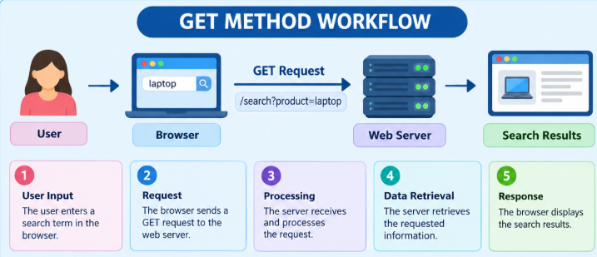
WORKFLOW OF GET
GET METHOD WORKFLOW
User Input: The user enters a search term in the browser.
Request: The browser sends a GET request to the web server.
Processing: The server receives and processes the request.
Data Retrieval: The server retrieves the requested information.
Response: The browser displays the search results.

Slide 6
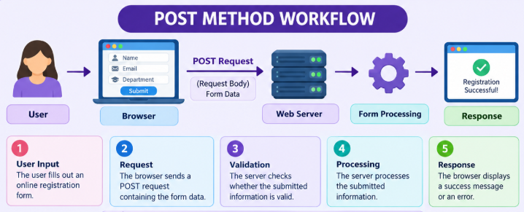
WORKFLOW OF POST
POST METHOD WORKFLOW
User Input: The user fills out an online registration form.
Request: The browser sends a POST request containing the form data.
Validation: The server checks whether the submitted information is valid.
Processing: The server processes the submitted information.
Response: The browser displays a success message or an error.

Slide 7
COMPARISON BETWEEN GET AND POST
Feature | GET Method | POST Method
Purpose | Retrieves information from the server. | Submits data to the server for processing.
Data Location | Usually included in the URL. | Usually included in the request body.
Visibility | Query parameters are visible in the URL. | Data is not normally displayed in the URL.
Bookmarking | Supports bookmarking and sharing search results. | Does not normally bookmark form submissions for resubmission.
Data Size | Limited by practical URL and server limits. | Supports larger payloads, depending on server limits.
Security | HTTPS protects data during transmission. | HTTPS protects data during transmission.
Common Uses | Searching, filtering, and viewing web pages. | Registration, form submission, and file uploads.

Slide 8
SECURITY AND REAL-TIME APPLICATIONS
SECURITY CONSIDERATIONS:
• URL Visibility: GET query parameters may appear in browser history, bookmarks, and server logs.
• Data Protection: POST does not automatically make submitted data secure or encrypted.
• HTTPS: HTTPS protects data during transmission for both GET and POST methods.
• Sensitive Information: Passwords and other sensitive information should not be placed in GET query parameters.
• Server-Side Validation: Both methods require proper input validation and appropriate authentication when necessary.

Slide 9
SECURITY AND REAL-TIME APPLICATIONS
REAL-TIME APPLICATIONS:
GET METHOD
• Searching for products on shopping websites.
• Filtering products by price, brand, or category.
• Viewing articles, news pages, and search results.
POST METHOD
• Creating student accounts and registering users.
• Submitting online application and contact forms.
• Uploading documents and sending information for processing.

Slide 10


